Slide 1
Basic database development cycle
Write documentation:
  How much data are we going to store (~600 individuals, ~536.000 SNPs, → ~10^8 rows)
  Collect use cases (how are we going to use it, which operations, when, etc..)
  Determine hardware and how it will be maintained.
  Which software (postgres, mysql, etc..) (DBMS)

Slide 2
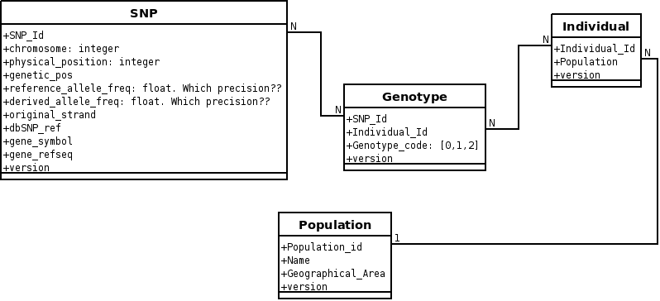
Basic database development cycle
Determine which tables are we going to use (UML entity schemas)

Slide 3
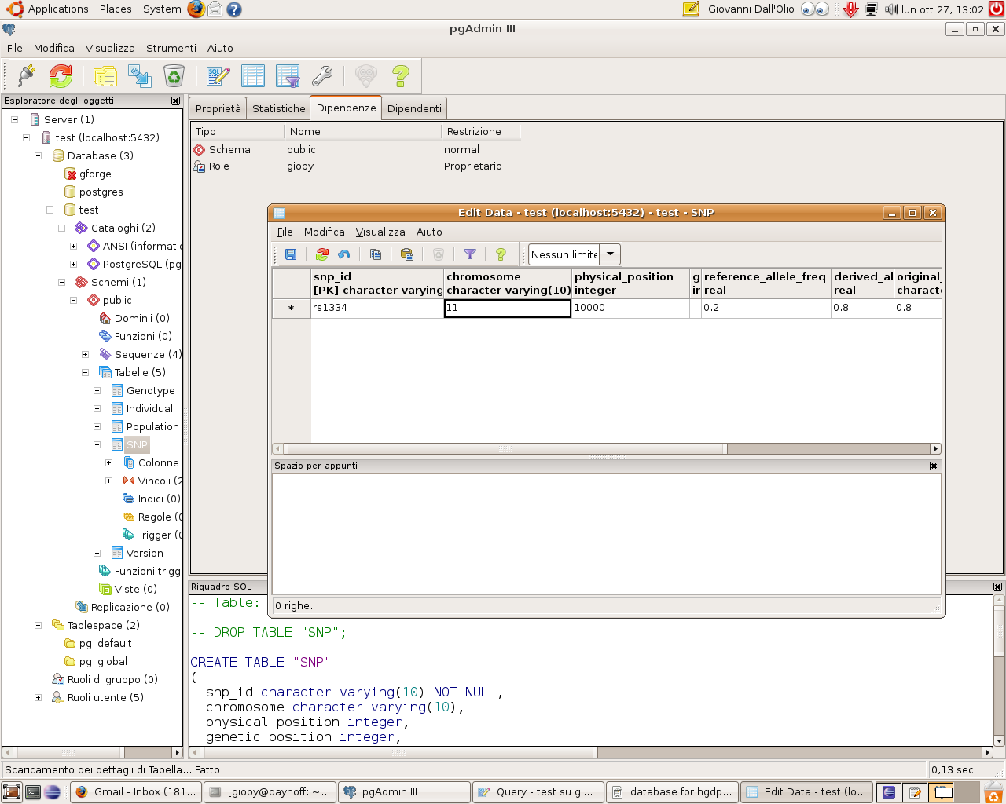
Basic database development cycle
Test the database with sample data

Slide 4
How to use it
Direct SQL:
  Select *
  from genotypes
  where....
ORM modules:
  >>> db_connection = sqlalchemy.metadata.connect('postgres', localhost, username, password)
  >>> db_connection.select('Individuals').filter_by('name == Einstein')

